Slide 1
A1 Chemistry
Benzene

Slide 2
Learning intentions
hydrocarbons, including benzene, have different chemical properties that are determined by the nature of the bonding within the molecules
benzene undergoes characteristic reactions such as combustion and substitution

Slide 3
Success criteria
Write the general formula for benzene
Name benzene derivatives (IUPAC)
Name one commonly used compound that contains benzene
Write equations for combustion and substitution of benzene

Slide 4

Benzene
Molecular formula C6H6
A unique ring shaped structure

Slide 5
Uses of benzene
Benzene is an additive to fuels; it improves the octane rating.
It is also used to “taint” pure ethanol, turning it from liquor to industrial alcohol.
It is also used to produce many other chemicals, such as plastics, pesticides and detergents.

Slide 6
Aromatic compounds
Many naturally occurring compounds contain the benzene ring.

Slide 7
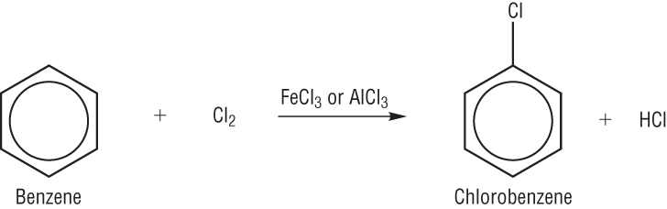
These are formed when other atoms or groups of atoms are substituted for one or more of benzene’s hydrogens.

Slide 8
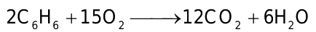
Combustion
Like all hydrocarbons, benzene will burn in oxygen to produce carbon dioxide and water.

Slide 9
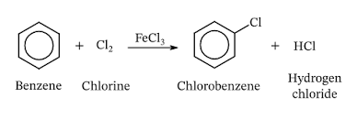
Substitution
Although benzene is not saturated, it reacts as if it has no double bonds. It will undergo substitution reactions with halogens.

Slide 10
Success criteria
Write the general formula for benzene
Name benzene derivatives (IUPAC)
Name one commonly used compound that contains benzene
Write equations for combustion and substitution of benzene

